Slide 2
Document Type Definition
In this first lesson, Document Type Definition, you will learn to:
  Define what is meant by a DTD.
  Identify the need for a DTD.

Slide 3
Definition of a DTD
Is a non XML document made up of element, attribute, and entity declarations.
Helps XML parsers to validate the XML document.
Helps authors to set default values for element attributes.
Document's tree structure can be determined based on the DTD.

Slide 4
Need for a DTD
DTD was introduced to fulfil the need for some sort of standardization of elements and attributes in an XML document.
A DTD:
  Can define all the possible combinations and sequences for elements to be used in an XML document along with their attributes and their acceptable values.

Slide 5
DTD versus DOCTYPE 1-3
Table lists difference between a Document Type Definition (DTD) and a Document Type Declaration (DOCTYPE).
Properties | Document Type Definition | Document Type Declaration
Definition | A list of legal element, attribute and entity declarations for an XML document. | The declaration of the DTD to which the XML document adheres to.
Abbreviation | DTD | DOCTYPE
Location | Within the DOCTYPE declaration or an external file | Within the XML document's prolog
Syntax | <!ELEMENT element-name (element-content)> ... <!ENTITY entity-name "entity-value"> ... <!DOCTYPE name_of_root_element SYSTEM "URL of the external DTD subset" > | <!ATTLIST element-name attribute-name attribute-type default-value> Or <!DOCTYPE name_of_root_element [ internal DTD subset ]>
Language Type | Non XML | XML
Variations | Present within a DOCTYPE (Internal DTD) or in an external document (External DTD) | Declaring either an internal or external DTD
Dependency | Is useful only if declared using DOCTYPE declaration | Is useful only if it has a DTD to define

Slide 6
DTD versus DOCTYPE 2-3
DOCTYPE declarations:
  Can declare DTDs within themselves or refer to DTDs present in external documents termed as internal or external respectively.
  The example shows how to declare a DTD within a DOCTYPE declaration.
Snippet
File: Mobile.xml
...
<!DOCTYPE Mobile [
<!ELEMENT Mobile (Company, Model, Price, Accessories)>
<!ELEMENT Company (#PCDATA)>
<!ELEMENT Model (#PCDATA)>
<!ELEMENT Price (#PCDATA)>
<!ELEMENT Accessories (#PCDATA)>
<!ATTLIST Model Type CDATA "Camera">
<!ENTITY HP "Head Phones">
<!ENTITY CH "Charger">
<!ENTITY SK "Starter's Kit">
]>
...

Slide 7
DTD versus DOCTYPE 3-3
The example displays the same DTD shown in the previous example but in the form of an external DTD.
The DTD is declared in a separate file "Mobile.dtd". The DOCTYPE declaration in the XML file refers to it using the SYSTEM keyword.
Snippet
File: Mobile.dtd
<!ELEMENT Mobile (Company, Model, Price, Accessories)>
<!ELEMENT Company (#PCDATA)>
<!ELEMENT Model (#PCDATA)>
<!ELEMENT Price (#PCDATA)>
<!ELEMENT Accessories (#PCDATA)>
<!ATTLIST Model Type CDATA "Camera">
<!ENTITY HP "Head Phones">
<!ENTITY CH "Charger">
<!ENTITY SK "Starter's Kit">
File: Mobile.xml
...
<!DOCTYPE Mobile SYSTEM "Mobile.dtd">
...

Slide 8
Limitations of DTD
DTDs validate XML documents but themselves are non-XML documents, so cannot boast extensibility.
DTDs can be either external or internal depending on their DOCTYPE declaration. This limits the advantage of having both internal and external DTDs.
DTDs do not follow the latest trends of being object oriented, inheritance, and so on.
XML documents can use multiple namespaces. However, DTDs do not support multiple namespaces.
DTDs support only one datatype, the text string.
Being able to define DTDs for standardizing XML documents is surely one of DTDs biggest tenets.
Internal DTDs being able to override external DTDs creates malicious internal DTDs. Thus, the security aspect of DTDs is very doubtful.

Slide 9
Working with DTDs
In this second lesson, Working with DTDs, you will learn to:
  Describe the structure of a DTD.
  Explain how to create a simple DTD.
  Describe what is meant by document type declarations.

Slide 10
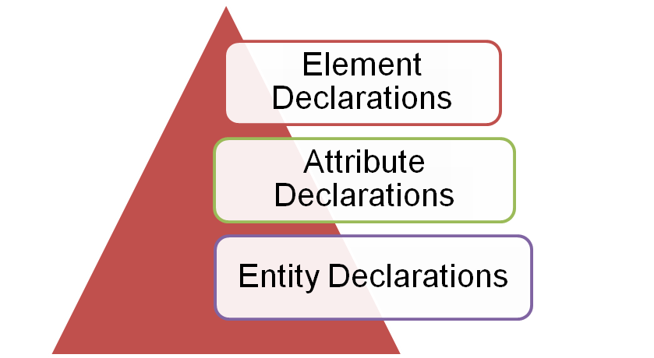
Structure of DTD
A typical DTD structure is composed of the following three blocks that can be declared in any sequence.
Element declaration: Specifies the name of the element, and the content which that element can contain.
Attribute declaration: Specifies the element that owns the attribute, the attribute name, its type, and its default value.
Entity declaration: Specifies the name of the entity and either its value or location of its value.

Slide 11
Creating Internal DTDs 1-2
Creating DTDs is a simple six step process that can be listed as follows:
  Declare all the possible elements.
  Specify the permissible element children, if any.
  Set the order in which elements must appear.
  Declare all the possible element attributes.
  Set the attribute data types and values.
  Declare all the possible entities.
Steps 1 to 3 deal with element declaration.
Steps 4 and 5 with attribute declarations.
Step 6 with entity declarations.
Syntax
<!ELEMENT element-name (element-content)>
…
<!ATTLIST element-name attribute-name attribute-type default-value>
…
<!ENTITY entity-name "entity-value">
…

Slide 12
Creating Internal DTDs 2-2
The code demonstrates the properties of internal DTDs.
Snippet
<!ELEMENT Mobile (Company, Model, Price, Accessories)>
<!ELEMENT Company (#PCDATA)>
<!ELEMENT Model (#PCDATA)>
<!ELEMENT Price (#PCDATA)>
<!ELEMENT Accessories (#PCDATA)>
<!ATTLIST Model Type CDATA "Camera">
<!ENTITY HP "Head Phones">
<!ENTITY CH "Charger">
<!ENTITY SK "Starters Kit">

Slide 13
DOCTYPE Declarations 1-2
Declares that the XML file in which it is present adheres to a certain DTD.
Specifies the name of that DTD and either its content or location.
Placed in the XML document's prolog.
Declaration begins with <!DOCTYPE and ends with a >.
In between is the name of the root element, followed either by a pair of square brackets containing the DTD itself or by the SYSTEM keyword and a URL specifying where the DTD can be found.

Slide 14
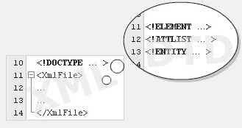
DOCTYPE Declarations 2-2
Figure shows the DOCTYPE declaration.
Syntax
<!DOCTYPE name_of_root_element [ internal DTD subset ]>
Or
<!DOCTYPE name_of_root_element SYSTEM "URL of the external DTD subset" >

Slide 15

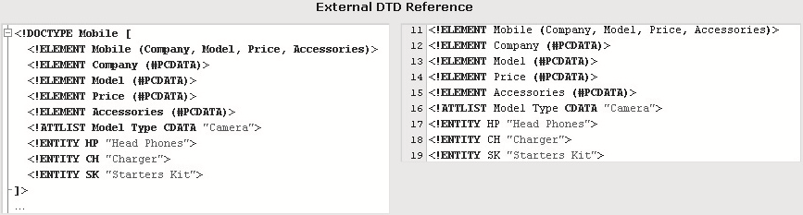
Types of DTDs
Internal DTDs:
  Are characterized by the presence of the DTD in the document type declaration itself.
  Consists of the DTD name followed by the DTD enclosed in square brackets.
  Figure depicts the internal DTD.
External DTDs:
  Are characterized by the presence of the DTDs address path in the document type declaration.
  Consists of the DTDs name followed by the SYSTEM keyword followed by the address of the DTD document.
  Figure depicts the external DTD.

Slide 16
Valid XML Documents
In this third lesson, Valid XML Documents, you will learn to:
  Define document validity.
  Describe in brief how to test for document validity.

Slide 17
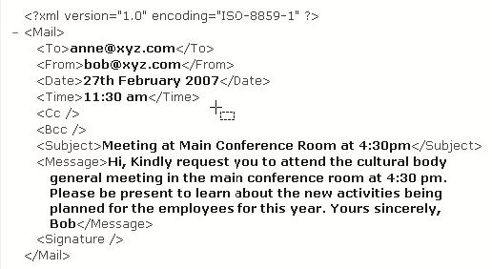
Well-Formed XML Documents
A well-formed XML document adheres to the basic XML syntax rules.
Basic XML syntax rules are as follows:
  All elements must be enclosed by the root element.
  All elements must have closing tags.
  All tags should be case sensitive.
  All elements must be properly nested.
  All attribute values must always be quoted.
Figure shows an example of well-formed XML document.

Slide 18
Valid XML Documents 1-2
Is a well-formed XML document that adheres to its DTD.
Is determined by checking it against its DTD.
Plays an important role in all XML applications.
Adhere to the declarations in the DTD, a well-formed XML document can be termed as a valid XML document.

Slide 19
Valid XML Documents 2-2
The code demonstrates a valid XML document.
Snippet
<?xml version="1.0" encoding="ISO-8859-1"?>
<!DOCTYPE Mail [
<!ELEMENT Mail (To, From, Date, Time, Cc, Bcc, Subject, Message, Signature)>
<!ELEMENT To (#PCDATA)>
<!ELEMENT From (#PCDATA)>
<!ELEMENT Date (#PCDATA)>
<!ELEMENT Time (#PCDATA)>
<!ELEMENT Cc (#PCDATA)>
<!ELEMENT Bcc (#PCDATA)>
<!ELEMENT Subject (#PCDATA)>
<!ELEMENT Message (#PCDATA)>
<!ELEMENT Signature (#PCDATA)>
]>
<Mail>
<To> anne@xyz.com </To>
<From> bob@xyz.com </From>
<Date> 27th February 2007 </Date>
<Time> 11:30 am </Time>
<Cc> </Cc>
<Bcc> </Bcc>
<Subject> Meeting at Main Conference Room at 4:30pm </Subject>
<Message> Hi, Kindly request you to attend the cultural body general meeting in the main conference room at 4:30 pm. Please be present to learn about the new activities being planned for the employees for this year. Yours sincerely, Bob </Message>
<Signature> </Signature>
</Mail>

Slide 20
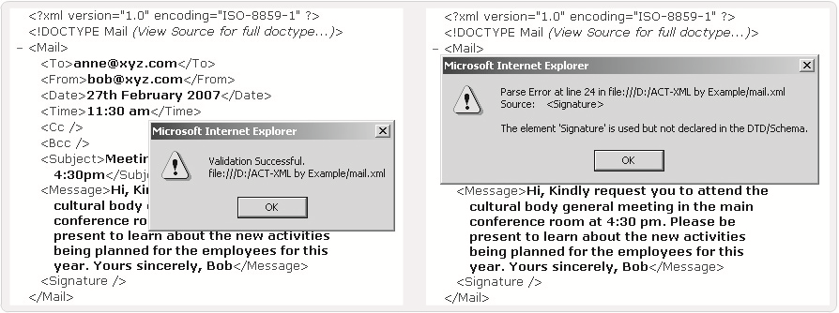
Testing XML for Validity
Validity of XML documents can be determined by using a validating parser such as MSXML 6.0 Parser.
To validate the code in the Internet Explorer (IE):
  Once the code is displayed in IE, right-click the code to display the context menu.
  The menu provides the option of validating the code.
  On selection, IE internally validates the code against the code's DTD.
Figure displays the validation result of a valid mobile.xml file as well as the validation result after the removal of the signature element from the document's DTD.

Slide 21
Declarations
In this last lesson, Declarations, you will learn to:
  Explain how to declare elements.
  Explain how to declare attributes.
  Describe entity declaration in a DTD.

Slide 22
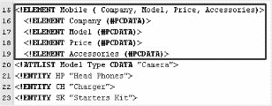
Declaring Elements 1-4
In the DTD, XML elements are declared with an element declaration.
where,
  ELEMENT is the keyword.
  element-name is the name of the element.
  element-rule can be one of the following: No Content, Only Parsed Character Data, Any Contents, Children, Only One Occurrence, Minimum One Occurrence, Zero or More Occurrences, Zero or One Occurrence, Either/Or Content, or Mixed Content.
Figure depicts an example of element declaration.
Syntax
<!ELEMENT element-name element-rule>

Slide 23
Declaring Elements 2-4
Table lists the syntax and declarations for the element-rule options.
Value | Description | Syntax | Example
No Content | These elements are empty and accept no data. | <!ELEMENT element-name EMPTY> | <!ELEMENT Signature EMPTY>
Only Parsed Character Data | Elements contain character data that needs to be parsed. | <!ELEMENT element-name (#PCDATA)> | <!ELEMENT Signature (#PCDATA)>
Any Contents | Elements can contain any combination of data that can be parsed. | <!ELEMENT element-name ANY> | <!ELEMENT Signature ANY>
Children | Elements with one or more children are defined with the name of the children elements inside parentheses followed by their declarations in the same order. | <!ELEMENT element-name (child-element-name)> or <!ELEMENT element-name (child-element-name, child-element-name,.....)> | <!ELEMENT Mail (To, From, Date, Time, Cc, Bcc, Subject, Message, Signature)> <!ELEMENT To (#PCDATA)> … …

Slide 24
Declaring Elements 3-4
Table lists shows additional declarations.
Value | Description | Syntax | Example
Only One Occurrence | Elements with children declared only once within the parentheses implicitly appear only once in the XML document. | <!ELEMENT element-name (child-name)> | <!ELEMENT Mail (To, From, Date, Time, Cc, Bcc, Subject, Message, Signature)>
Minimum One Occurrence | Element children names accompanied by a ‘+’ sign inside the parentheses should appear at least once in the XML document. | <!ELEMENT element-name (child-name+)> | <!ELEMENT Mail (To+, From+, Date+, Time+, Cc, Bcc, Subject+, Message+, Signature)>
Zero or More Occurrences | Elements with children names accompanied by a ‘*’ sign inside the parentheses can or cannot appear in the XML document. | <!ELEMENT element-name (child-name*)> | <!ELEMENT Mail (To*, From+, Date+, Time+, Cc, Bcc, Subject+, Message+, Signature)>
Zero or One Occurrences | Elements with children names accompanied by a ‘?’ sign inside the parentheses can be skipped or only appear once in the XML document. | <!ELEMENT element-name (child-name?)> | <!ELEMENT Mail (To*, From+, Date+, Time+, Cc, Bcc, Subject+, Message+, Signature?)>

Slide 25
Declaring Elements 4-4
Value | Description | Syntax | Example
Either/Or Content | Elements can have either one of two or more children by specifying them in parentheses separated by ‘|’. | <!ELEMENT element-name (child-name, (child-name|child-name)…)> | <!ELEMENT Mail (To, From, Date, Time, (Cc|Bcc), Subject, Message, Signature)>
Mixed Content | Elements can be declared to accept mixed content, either data type or children, etc. | <!ELEMENT element-name (type|child-name|…)> | <!ELEMENT Mail (To|From|Date|Time|Cc|Bcc|Subject|Message|Signature)>

Slide 26
Declaring Attributes
Syntax
  where,
  element-name is the element the attribute belongs to,
  attribute-name is the name of the attribute,
  attribute-type is type of data the attribute can accept,
  default-value is the default value for the attribute.
Table lists the attribute-type values.
<!ATTLIST element-name attribute-name attribute-type default-value>
Value | Description
PCDATA | Parsed character data
CDATA | Character data
(en1|en2|..) | Enumerated list
ID | A unique id
IDREF | Id of another element
IDREFS | List of other ids
NMTOKEN | Valid XML name
NMTOKENS | List of valid XML names
ENTITY | An entity
ENTITIES | List of entities
NOTATION | Name of a notation
xml: | Predefined xml value

Slide 27
Specifying Attribute Values 1-2
Table lists the attribute–value in a DTD declaration.
#IMPLIED
  <!ATTLIST element-name attribute-name attribute-type #IMPLIED>
#REQUIRED
  <!ATTLIST element-name attribute-name attribute-type #REQUIRED>
#FIXED
  <!ATTLIST element-name attribute-name attribute-type #FIXED "value">
Enumerated Attribute Values
  <!ATTLIST element-name attribute-name (en1|en2|..) default-value>
  <!ATTLIST payment type (check|cash) "cash">
Value | Description
value | Default value
#REQUIRED | Value must be included
#IMPLIED | Value does not have to be included
#FIXED | Value is fixed
en1|en2|... | Listed enumerated values

Slide 28
Specifying Attribute Values 2-2
The code demonstrates the attribute values.
Snippet
--Default Value
<!ATTLIST Model Type CDATA "Camera">
--#IMPLIED
<!ATTLIST Model Type CDATA "Camera" #IMPLIED>
--#REQUIRED
<!ATTLIST Model Type CDATA #REQUIRED>
--#FIXED
<!ATTLIST Model Type CDATA #FIXED "Camera">
--Enumerated Attribute Values
<!ATTLIST Model Type (Camera|Bluetooth) "Camera">

Slide 29
Entities in DTD 1-3
An XML entity:
  Is a placeholder that consists of a name and a value.
  Is declared once and then repeatedly used through out the document in place of its value.
  Can be categorized as parameter entities and general entities.
General entities:
  Character
  Mixed Content
  Unparsed
Character entities:
  Pre-defined
  Numbered
  Name

Slide 30
Entities in DTD 2-3
Table lists the Pre-defined entities and their references.
Numbered entities are entities which use a character reference number, for a character from the Unicode character set, in place of the character itself.
  &#x(reference number in hexadecimal);
Name entities are the same as Numbered entities, except that the numbers are replaced by a descriptive name for the character.
Mixed content entities are entities that contain either text or markup language text as their replacement value.
Unparsed entities are entities that have data that is not to be parsed.
  Example: <!DOCTYPE name [
      <!ENTITY entity-name SYSTEM "entity-location" NDATA Notation Identifier>
      ]>
Entity Name | Value
amp | &
apos | '
gt | >
lt | <
quot | "

Slide 31
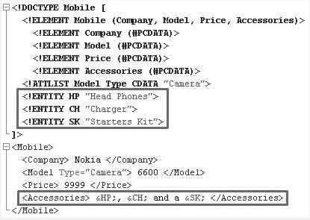
Entities in DTD 3-3
Entity declaration
Entity Reference
Figure depicts the entities in DTD.
Syntax
<!ENTITY entity-name "entity-value">
Syntax
&entity-name;

Slide 32
Kinds of Entity Declarations 1-3
Internal Entity Declaration
  In internal entity declarations, the entity value is explicitly mentioned in the entity declaration.
  The code demonstrates the properties of internal entity declaration.
Syntax
<!ENTITY entity-name "entity-value">
Snippet
<!DOCTYPE Mobile [
<!ELEMENT Mobile (Company, Model, Price, Accessories)>
<!ELEMENT Company (#PCDATA)>
<!ELEMENT Model (#PCDATA)>
<!ELEMENT Price (#PCDATA)>
<!ELEMENT Accessories (#PCDATA)>
<!ATTLIST Model Type CDATA "Camera">
<!ENTITY HP "Head Phones">
<!ENTITY CH "Charger">
<!ENTITY SK "Starters Kit">
]>
<Mobile>
<Company> Nokia </Company>
<Model Type="Camera"> 6600 </Model>
<Price> 9999 </Price>
<Accessories> &HP;, &CH; and a &SK; </Accessories>
</Mobile>

Slide 33
Kinds of Entity Declarations 2-3
External Entity Declaration
  In External entity declaration, a link or path to the entity value is mentioned in place of the entity value with the help of the SYSTEM keyword.
  The code demonstrates the properties of external entity declaration.
Syntax
<!ENTITY entity-name SYSTEM "URI/URL">
Snippet
<!DOCTYPE Mobile [
<!ELEMENT Mobile (Company, Model, Price, Accessories)>
<!ELEMENT Company (#PCDATA)>
<!ELEMENT Model (#PCDATA)>
<!ELEMENT Price (#PCDATA)>
<!ELEMENT Accessories (#PCDATA)>
<!ATTLIST Model Type CDATA "Camera">
<!ENTITY HP SYSTEM "hp.txt">
<!ENTITY CH SYSTEM "ch.txt">
<!ENTITY SK SYSTEM "sk.txt">
]>

Slide 34
Kinds of Entity Declarations 3-3
Snippet
<Mobile>
  <Company> Nokia </Company>
  <Model Type="Camera"> 6600 </Model>
  <Price> 9999 </Price>
  <Accessories> &HP;, &CH; and a &SK; </Accessories>
</Mobile>
hp.txt
Head Phones
ch.txt
Charger
sk.txt
Starters Kit

Slide 35
Summary
In this module, Document Type Definitions, you learnt about:
  Document Type Definition
    This lesson defines DTDs and identifies the need for DTDs.
  Working with DTDs
    This lesson talks about the structure of DTDs, steps to create DTDs, DOCTYPE declarations, and the type of DTDs.
  Valid XML Documents
    This lesson talks about the well-formed valid documents and the steps to determine the validity of XML documents.
  Declarations
    This lesson deals with declarations of elements, attributes, and entities in DTDs.

